Slide 1
Mini Project and Seminar
Class & Batch: M8 Project No.: 3
Presentation on “DUAL SECURITY LOCKER USING GSM MODULE”
BY :
ROLL NO.: NAME:
3847 RACHIT THAKUR
Project Guide:
Prof. R.J. SUTAR
Department of Electronics and Telecommunications
Pune Institute of Computer Technology
Academic Year : 2016 - 2017

Slide 2
Introduction :
1.Why do we need locks ?
2.Digital locks vs analog locks.
(a) secure
(b) smart!
(c) price
3.Our aim .

Slide 3
Literature Survey :
home security system using the GSM technology .
Published in: International Conference on Advances in Electrical Engineering (ICAEE), 2013
a GSM based digital door lock security system using PIC platform.
Published in: Power, Instrumentation, Control and Computing (PICC), 2015 International Conference on Advances in Electrical Engineering (ICAEE), 2015
three level security system using (RFID) and (GSM) modules
Published in: India Educators' Conference (TIIEC), 2013 Texas Instruments
theft control system for security lockers, homes, bank lockers, jewelry outlets, etc.
Published in: Signal Processing And Communication Engineering Systems (SPACES), 2015 International Conference on Advances in Electrical Engineering (ICAEE), 2015

Slide 4
Problem Definition :
To design a locker whose latch opens only after entering two passwords which are entered through SMS and keypad.
Objectives :
Learn about LCD and keypad and Interface it with pic18f4550 microcontroller.
Learn about GSM module and Interface it with pic18f4550 microcontroller.
Learn about servo motor and Interface it with pic18f4550 microcontroller.
Compile and interface all the above modules together .

Slide 5
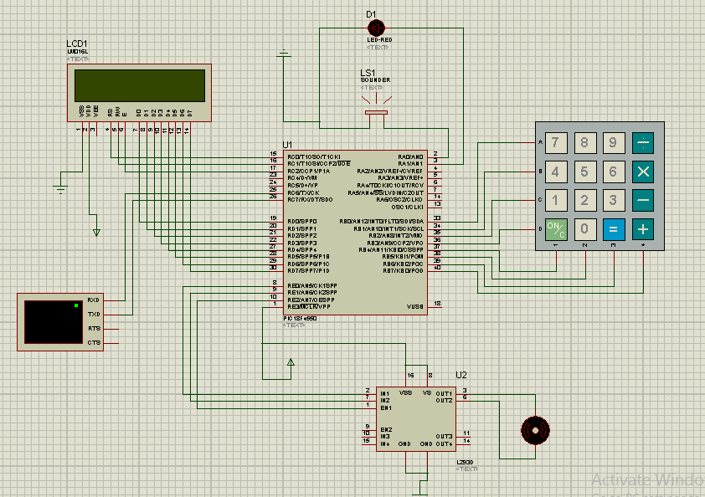
Block Diagram :

Slide 6
Hardware Requirements
Various important blocks needed for implementation of this project are as follows:
Microcontroller(PIC18F4550)
16x2 LCD display(LM016)
Piezoelectric Buzzer
LED(Red,3mm)
Dc motor
Power supply
GSM module(SIM800)
Keypad module

Slide 7
PROGRAMMING APPROACH:
LCD:
We have selected PORTD of PIC18 for LCD data lines as there are total 8 pins i.e from RD0 to RD7 which are suitable for passing 8 bit data.
For LCD commands, RC0,RC1 and RC2 pins are made as input for register select,read/write and enable pins.

Slide 8
Algorithm:
1.Intialize LCD.
2.Clear LCD.
3.Point the cursor from you want to start writing on LCD.
4. Put data on PORTD.
5. SET RS AND PW.
6. Give high to low voltage on LCD.

Slide 9
KEYPAD:
We have assigned PORTB to interface keypad with PIC18.
Rows : RB0 to RB3
Columns : RB4 to RB7

Slide 10
Algorithm:
WHENEVER key is pressed PORTD!=0XF0,
The value associated to the key is send to the LCD as data.
Else it iterates continuously inside while
‘t’ as counter increases every time key is pressed and the while has a condition of t<4 .
So, only 4 times the key can be pressed.

Slide 11
LED:
After entering the password, if a match occurs, an LED starts glowing which indicates that the locker latch is open.
So we connected an LED to PORTA pin RA1.
BUZZER:
If the second password entered is sensed to be wrong, buzzer starts operating hence a buzzer is connected to PORTA pin RA2.

Slide 12
DC MOTOR:
When both the passwords entered through keypad are matched, the locker is now unlocked which is to be indicated by opening of the door of the locker.
For this purpose, we have interfaced dc motor via a motor driver L293D to PORTE pins RE0,RE1 and RE2.

Slide 13
Algorithm:
1. IN1 is connected to PORTE0 AND IN1 is connected to PORTE1.(for rotation direction).
2. Motor on is decided by enable pin.
3.To open give PORTE0=1 and PORTE1=0,
And opposite to close lock.

Slide 14
GSM MODULE:
TYPES.
OVERVIEW
FEATURES
OUR USE.

Slide 15
Algorithm:
PIC’S transmission PIN is connected to recieving pin OF GSM MODULE.
PIC’S recieving PIN is connected to transmission pin OF GSM MODULE.
AT COMMANDS.
COMMUNICATION.

Slide 16
HARDWARE APPROACH:
First approach- simulation on softwares such as proteus.
Need of hardware.
Short description.(Introduction)

Slide 17
PCB DESIGN AND LAYOUT:
What is PCB? Need?
Types.
In our project, we attempted to design a single layer PCB using one of the most widely used softwares- i.e Cadsoft Eagle 7.6.0.
Eagle has a clean and easy to understand environment and a large component library.

Slide 18
Software Requirements
MPLAB IDE
C18 Compiler
HID Bootloader
Proteus 8
Any PCB designing software such as eagle , Ultium,proteus,etc

Slide 19
LOCKER DESIGN:
DIMENSIONS
SIDE FACING KEYPAD AND LCD.
ABSTRACTION.
STURDY

Slide 20
References :
1. G. M. S. Mahmud Rana, A. A. Mamun Khan, M. N. Hoque and A. F. Mitul, "Design and implementation of a GSM based remote home security and appliance control system," 2013 2nd International Conference on Advances in Electrical Engineering (ICAEE), Dhaka, 2013, pp. 291-295.
http://ieeexplore.ieee.org/document/6750350/
2. A. Ibrahim, A. Paravath, P. K. Aswin, S. M. Iqbal and S. U. Abdulla, "GSM based digital door lock security system," 2015 International Conference on Power, Instrumentation, Control and Computing (PICC), Thrissur, 2015, pp. 1-6.
http://ieeexplore.ieee.org/document/7455796/
3. P. S. R. Teja, V. Kushal, A. S. Srikar and K. Srinivasan, "Photosensitive security system for theft detection and control using GSM technology," 2015 International Conference on Signal Processing and Communication Engineering Systems, Guntur, 2015, pp. 122-125.
http://ieeexplore.ieee.org/document/7058229/
4. A. Vishwanath et al., "RFID and GSM Based Three Level Security System," India Educators' Conference (TIIEC), 2013 Texas Instruments, Bangalore, 2013, pp. 200-204.
http://ieeexplore.ieee.org/document/6757140/

Slide 21
Thank you

